Slide 1
EXPLORATORY DATA ANALYSIS
(EDA)

Slide 2
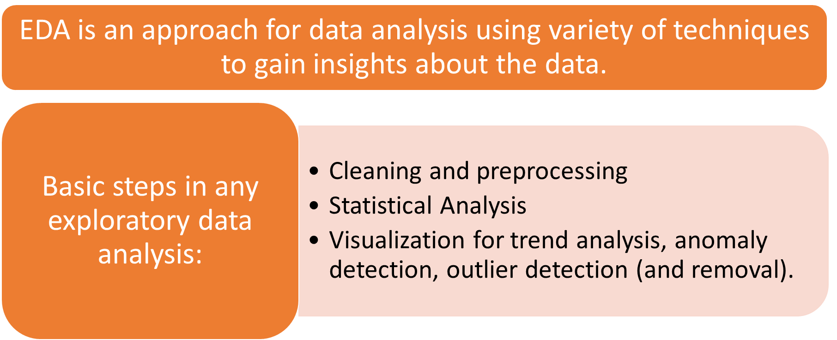
What is Exploratory Data Analysis

Slide 3
Exploratory Data Analysis
Get Data
Exploratory Data Analysis
Preprocessing
Data Mining

Slide 4
WHAT IS EDA?
The analysis of datasets based on various numerical methods and graphical tools.
Exploring data for patterns, trends, underlying structure, deviations from the trend, anomalies and strange structures.
It facilitates discovering unexpected as well as conforming the expected.
Another definition: An approach/philosophy for data analysis that employs a variety of techniques (mostly graphical).

Slide 5
Exploratory data analysis (EDA)
Exploring your data is a crucial step in data analysis. It involves:
Organising the data set
Plotting aspects of the data set
Maybe producing some numerical summaries; central tendency and spread, etc.
“Exploratory data analysis can never be the whole story, but nothing else can serve as the foundation stone.”
- John Tukey.

Slide 6
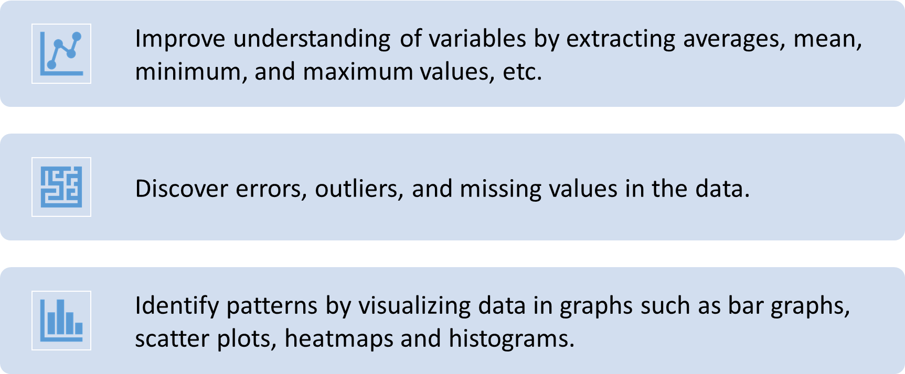
Importance of EDA

Slide 7
EXAMPLE 1
Data from the Places Rated Almanac *Boyer and Savageau, 1985)
9 variables fro 329 metropolitan areas in the USA
Climate mildness
Housing cost
Health care and environment
Crime
Transportation supply
Educational opportunities and effort
Arts and culture facilities
Recreational opportunities
Personal economic outlook
+ latitude and longitude of each city
Questions:
How is climate related to location?
Are there clusters in the data (excluding location)?
Are nearby cities similar?
Any relation bw economic outlook and crime?
What else???

Slide 8
EXAMPLE 2
In a breast cancer research, main questions of interest might be
Does any treatment method result in a higher survival rate? Can a particular treatment be suggested to a woman with specific characteristic?
Is there any difference between patients in terms of survival rates (e.g. Are white woman more likely to survive compare the black woman if they are both at the same stage of disease?)

Slide 9
EXAMPLE 3
In a project, investigating the well-being of teenagers after an economic hardship, main questions can be
Is there a positive ( and significant) effect of economic problems on distress?
Which other factors can be most related to the distress of teenagers? e.g. age, gender,…?

Slide 10
What is data?
A bunch of numbers (usually)
Each number summarises some property or event of interest
  e.g. 18
  Age, Beck Depression Inventory (BDI) score, Income in £’000s
Data: lots of numbers
  e.g. 18, 24, 43, 22, 37, …
Is there a pattern?

Slide 11
Types of Data
Types of
Data
Quantitative
Qualitative
Data
Data
© 2011 Pearson Education, Inc

Slide 12
Quantitative Data
Measured on a numeric scale.
Number of defective
items in a lot.
Salaries of CEOs of
oil companies.
Ages of employees at
a company.
4
943
52
21
12
120
8
71
3
© 2011 Pearson Education, Inc

Slide 13


Qualitative Data
Classified into categories.
College major of each
student in a class.
Gender of each employee
at a company.
Method of payment
(cash, check, credit card).
$
Credit

Slide 14
Attributes
Data points or Samples are described by attributes.
Attribute (or dimensions, features, variables): a data field, representing a characteristic or feature of a data object.
Types
  Nominal or Categorical
  Ordinal
  Binary
  Numerical

Slide 15
Attribute types
Nominal: categories, states, or “names of things”
  Hair color = {black, blond, brown, grey, red, white}
  marital status, occupation, ID numbers, zip codes
Ordinal: Values have a meaningful order (ranking) but magnitude between successive values is not known.
  Size = {small, medium, large}, grades, army rankings
Binary: Nominal attribute with only 2 states (0 and 1)
  Symmetric binary: both outcomes equally important, e.g., gender
  Asymmetric binary: outcomes not equally important. e.g., medical test (positive vs. negative)
Numeric: represents quantity (integer or real-valued)
  Temperature, length, counts, grade point, CGPA, salary etc.

Slide 16
DISCRETE vs. continuous attributes
Discrete Attribute: has only a finite or countably infinite set of values
  E.g., zip codes, profession, or the set of words in a collection of documents
  Sometimes, represented as integer variables
  Note: Binary attributes are a special case of discrete attributes
Continuous Attribute: has real numbers as attribute values
  E.g., temperature, height, or weight
  Continuous attributes are typically represented as floating-point variables

Slide 17
A sample Dataset
outlook | temperature | humidity | windy | play
sunny | 85 | 85 | FALSE | no
sunny | 80 | 90 | TRUE | no
overcast | 83 | 86 | FALSE | yes
rainy | 70 | 96 | FALSE | yes
rainy | 68 | 80 | FALSE | yes
rainy | 65 | 70 | TRUE | no
overcast | 64 | 65 | TRUE | yes
sunny | 72 | 95 | FALSE | no
sunny | 69 | 70 | FALSE | yes
rainy | 75 | 80 | FALSE | yes
sunny | 75 | 70 | TRUE | yes
overcast | 72 | 90 | TRUE | yes
overcast | 81 | 75 | FALSE | yes
rainy | 71 | 91 | TRUE | no

Slide 18
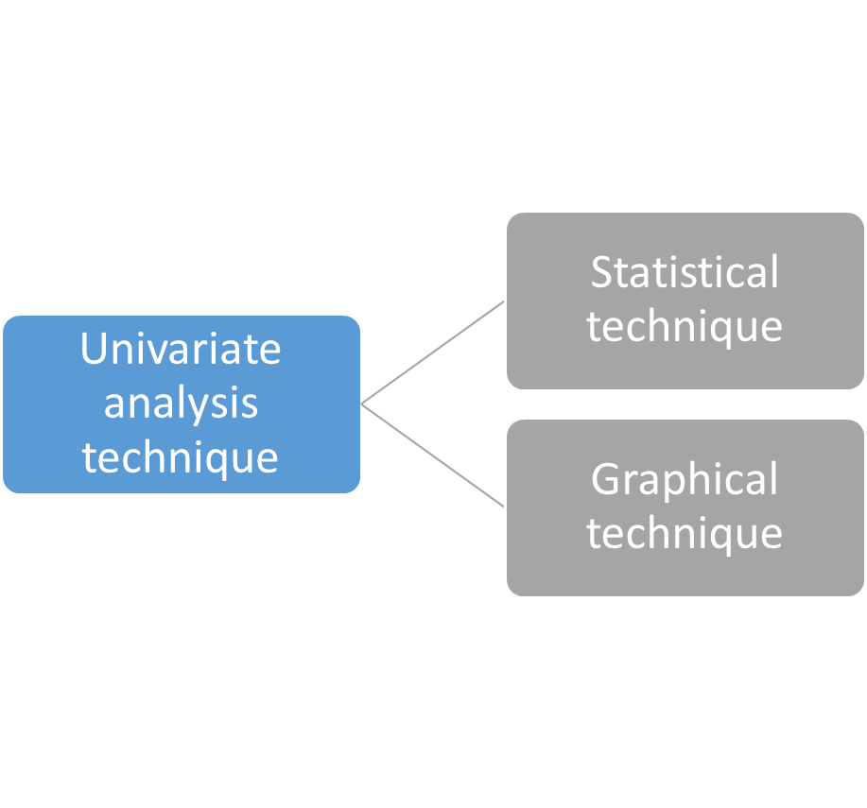
Univariate Analysis
  Univariate analysis techniques

Slide 19
Univariate Analysis
Some statistical methods for univariate analysis include looking at:
Mean
Median
Mode
Range
Variance
Maximum
Minimum
Quartiles
Standard deviation.
  Use of statistical techniques in univariate analysis

Slide 20
Univariate Analysis
Some graphical methods for univariate analysis involve preparing:
frequency distribution tables
bar charts
Histograms
frequency polygons
pie charts.
  Use of graphical techniques in univariate analysis

Slide 21
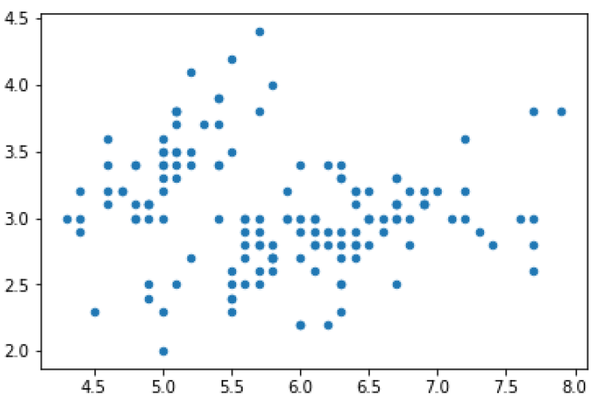
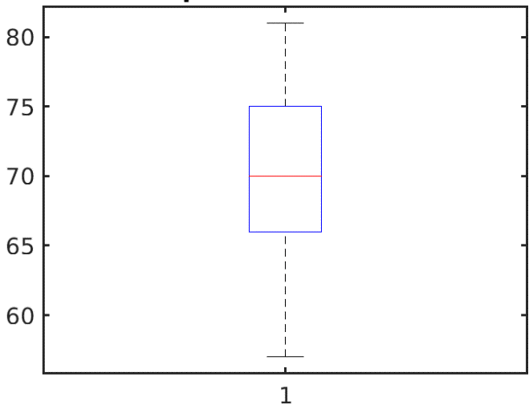
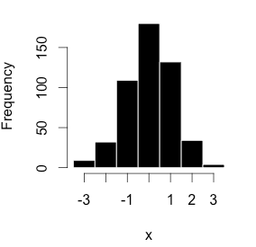
Examples of graphical method for univariate analysis
Scatter plot
Boxplot
Histogram

Slide 22
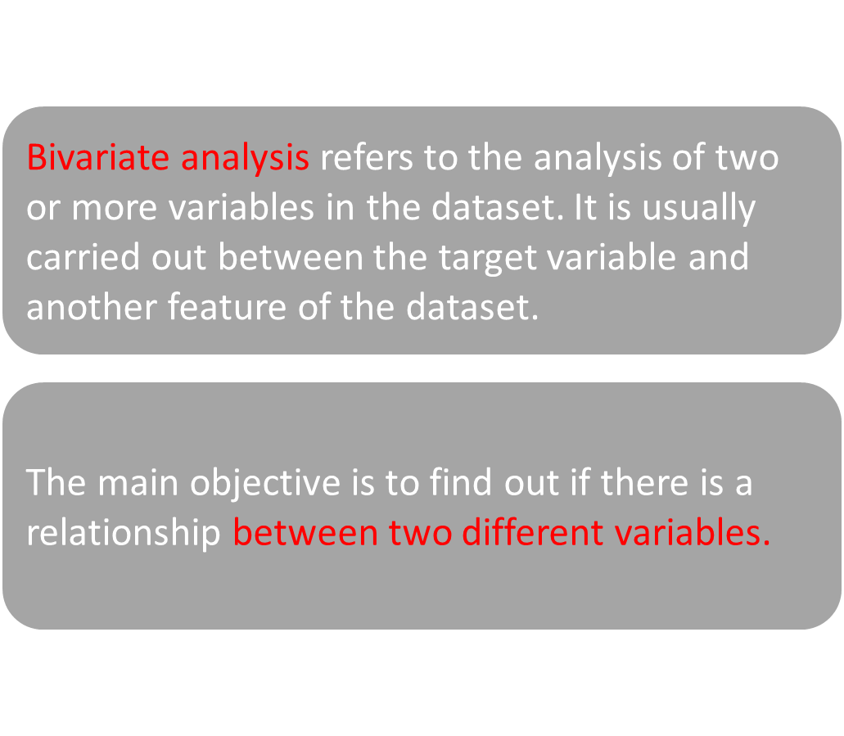
Bivariate Analysis

Slide 23
Bivariate Analysis
Bivariate analysis is usually done by using graphical methods like
scatter plots
line charts
pair plots.
  What are the different methods to perform bivariate analysis?

Slide 24
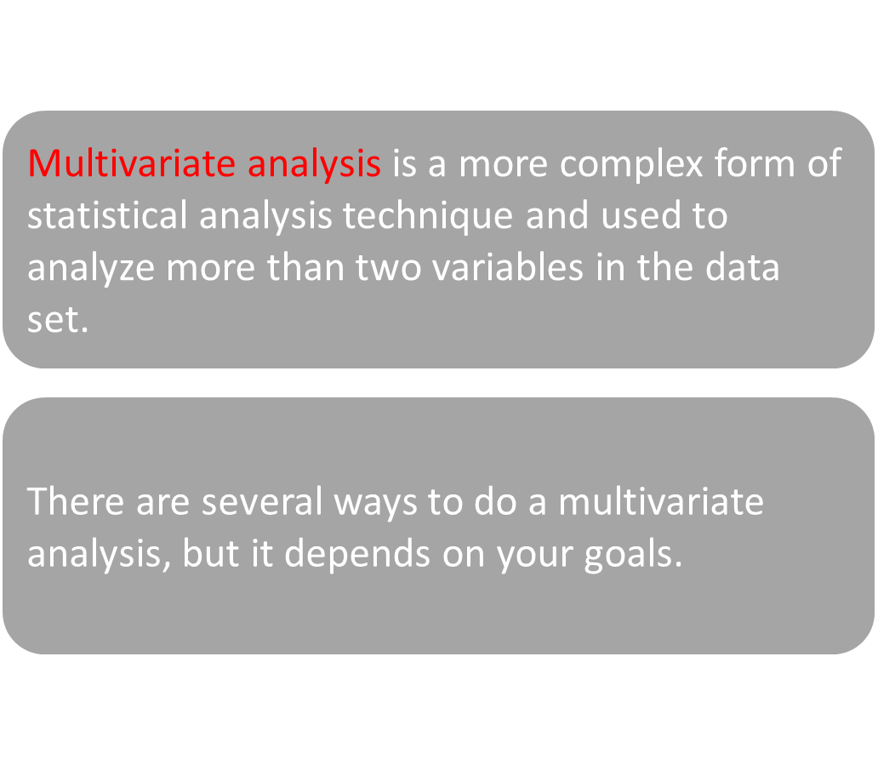
Multivariate Analysis

Slide 25
Multivariate Analysis
Different methods to perform multivariate analysis are:
Canonical Correlation Analysis
Cluster Analysis
Contour plots
Principal Component Analysis.
  What are the different methods to perform multivariate analysis?

Slide 26


